Slide 1

Will Anyone Download My App? (other than my mom ☹)
Team 3:
Shilpi Ray
Becky Li
Bryce Dudka

Slide 2
Main objective
Predict how many downloads an app will get based on it’s characteristics
Data: Google play store data
10,841 records
Columns:
App Name
Category (games; communication; lifestyle, etc.)
Rating (0-5)
Number of reviews
Size (in MB)
Number of Installs (1000+, 5000+ , 10,000+, etc.)
Paid or Free
Price
Content Rating (all ages, mature 17+, teenager)

Slide 3
DATA cleaning process and Summary
Primary cleaning activities took place in Excel
Converted any text strings to integers
All data came through as text including numbers
Removed special characters all fields
E.g. Ã,Å, ©, ¶ thousands of records impacted
Converted file size to integers
denoted as MB and KB to millions and thousands)
Summarized data in Tableau:
https://public.tableau.com/profile/becky.li#!/vizhome/FinalGroupProject_15730964044550/Story1?publish=yes

Slide 4
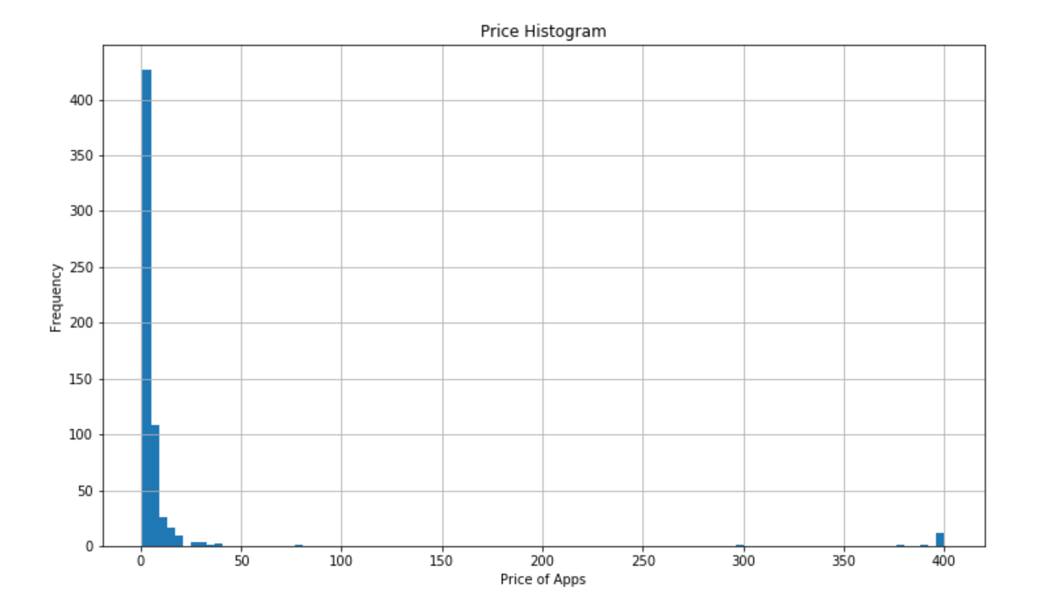
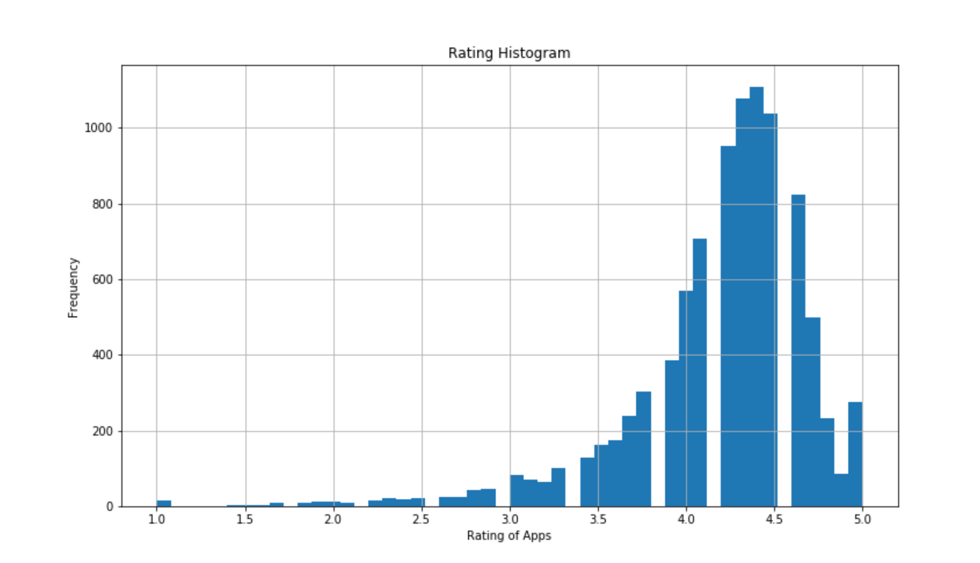
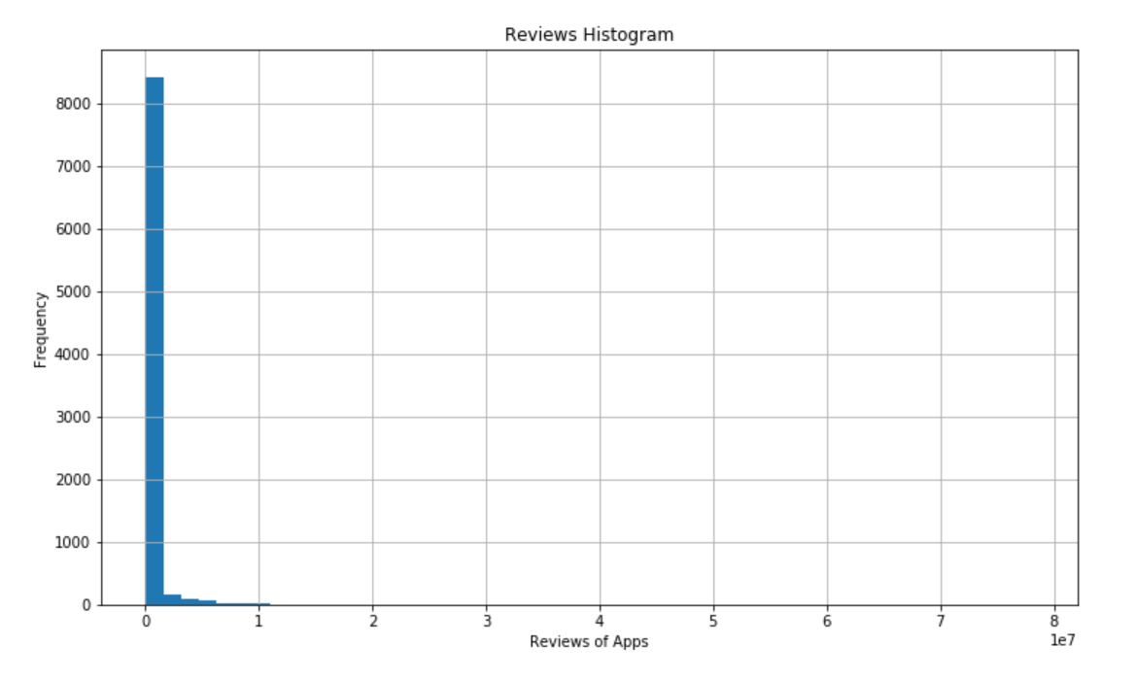
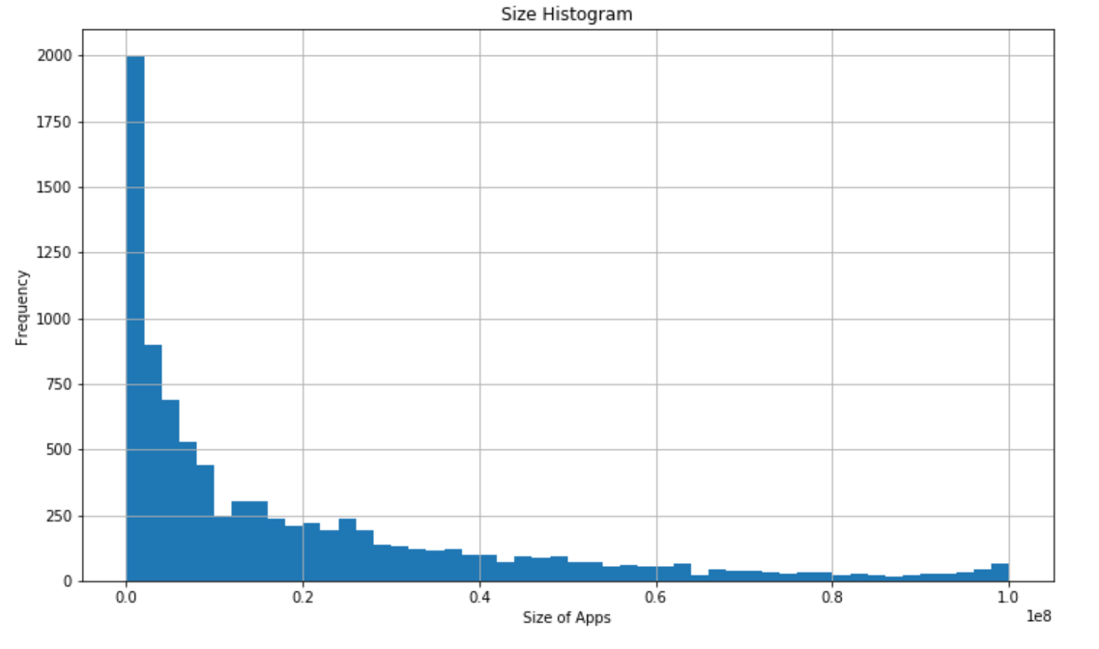
Finding A Model: distribution
Cleaned data set was 8,892 records: Began by analyzing input variables to understand shape
Price
Rating
Key takeaway: Ratings variable normally distributed, others skewed toward lower values
Majority were free
avg rated >4
Reviews
Size
Typically <300K reviews
Typically small file size

Slide 5
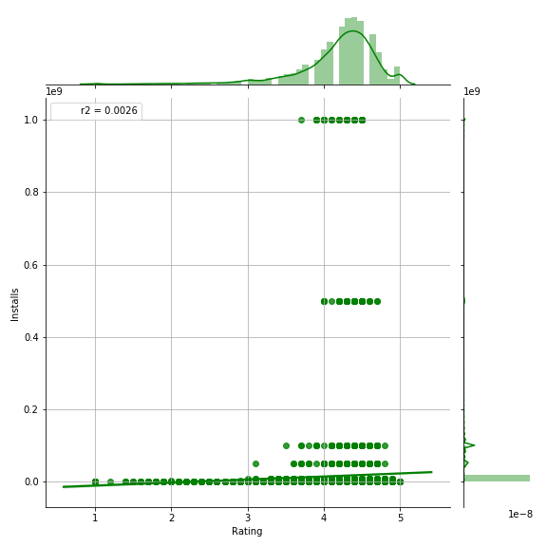
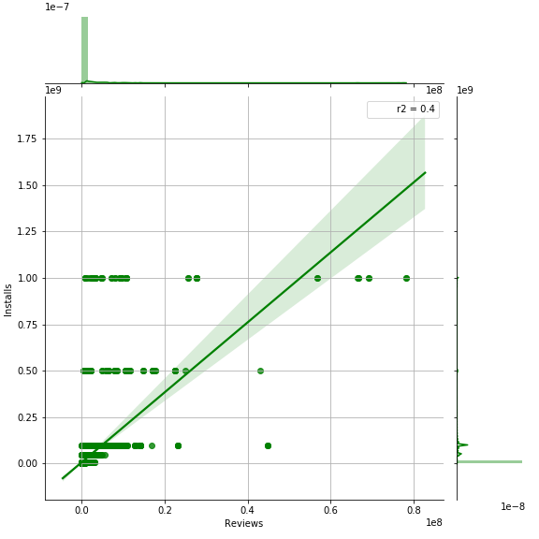
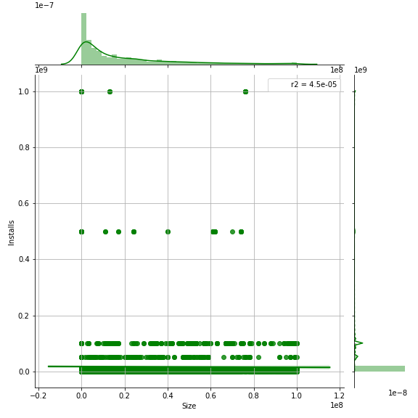
Finding A Model: Significance of Numerical Data
Tested significance of variables by finding R^2 and P values using regression on numerical data only
Rating
Reviews
Size
R^2: 0.0026
P-value:3.2908985369114987e-09
R^2: 0.4
P-value: 0.00
R^2: 4.5e-.05
P-value: 0.4420789414684386
Key takeaway: Number of Reviews were most statistically significant

Slide 6
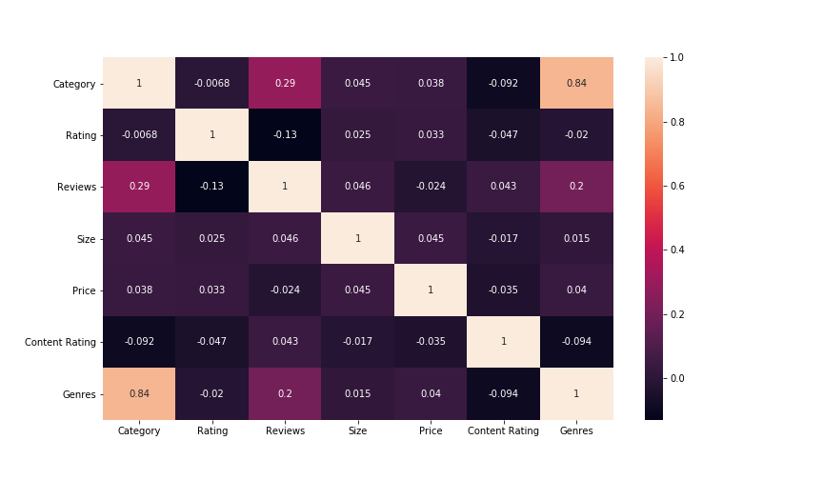
Finding A Model: Significance of Categorical Data (Correlation)
Used label encoder to find out if columns in data set were correlated with each other
Key takeaway: First step was a broad swipe to throw out highly correlated columns since those can cause problems with fitting the model and interpreting results. Removed column “Genres”

Slide 7
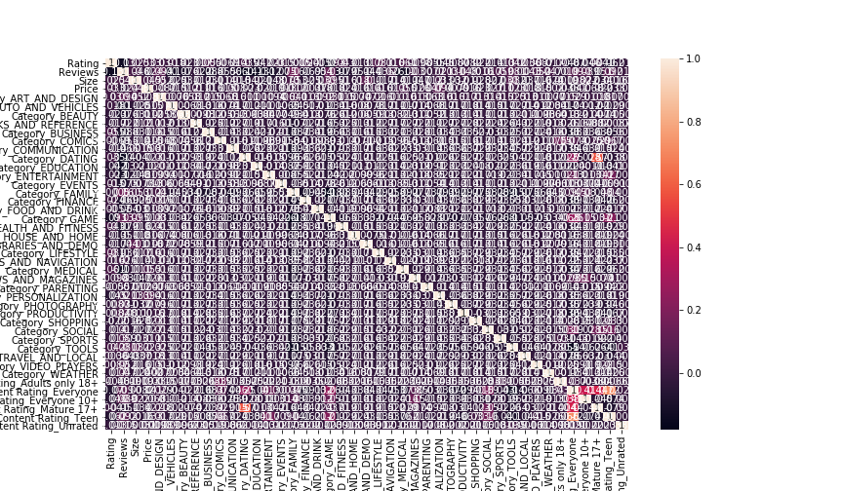
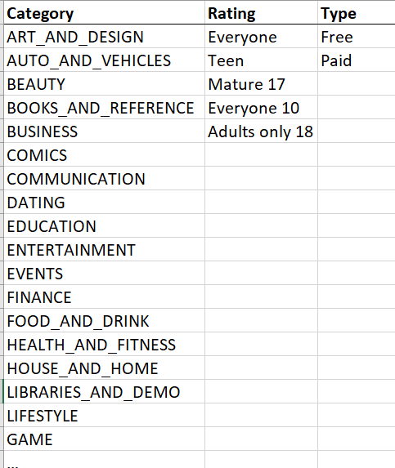
Finding A Model: Significance of Categorical Data (Correlation Cont.)
Used get dummies binary encoder to find correlation of all values within cells in all columns (e.g column “Categories” contains 34 unique values)
Key takeaway: Result was 44x44 matrix – difficult to read and interpret

Slide 8
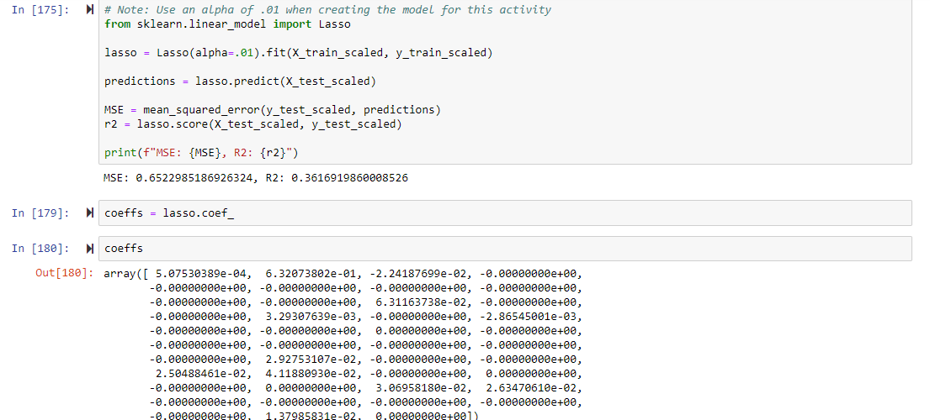

Finding A Model: Significance of Categorical Data (Correlation Cont.)
Used Lasso Regression to automate variable selection.
LASSO = Least Absolute Shrinkage and Selection Operator
Also a loop or rope designed a restraint to be thrown around a target
Key takeaway: Out of all 44 variables, Lasso selected 12.

Slide 9
Finding A Model: Quest for >=0.80 Training
Of 44 variables, only Lasso found these 12 as important:
Reviews
Size
Rating
Category_COMICS
Category_EDUCATION
Category_EVENTS
Category_MEDICAL
Category_PERSONALIZATION
Category_PHOTOGRAPHY
Category_TOOLS
Category_TRAVEL_AND_LOCAL
Content Rating_Mature 17+"
First Training!
Used all 44 variables to train decision tree classification prediction model. Score? 0.36, not great.
Second Training!
Used 12 variables from Lasso Regression to train decision tree classification model. Score? 0.43, better but still not great.
Key takeaway: The best training score we could get using Lasso variables as 0.43.

Slide 10
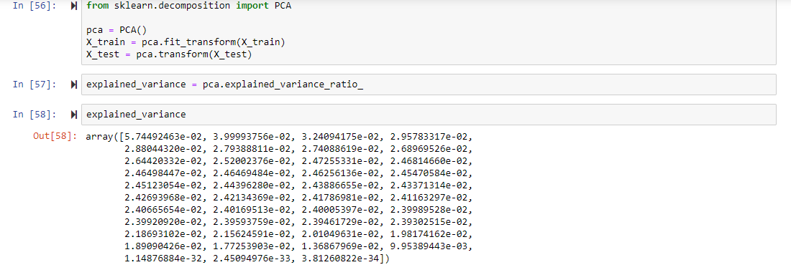
Finding A Model: Quest for >=0.80 PCA
Since the best we could with Lasso variables was 0.43, we used Principal Component Analysis (PCA) as an alternative way to measure significance across 44 variables.
Key takeaway: Out of all 44 variables, PCA found that either every single variables was either very significant, or not significant at all. Thanks, PCA – VERY HELPFUL. We left them all in.

Slide 11
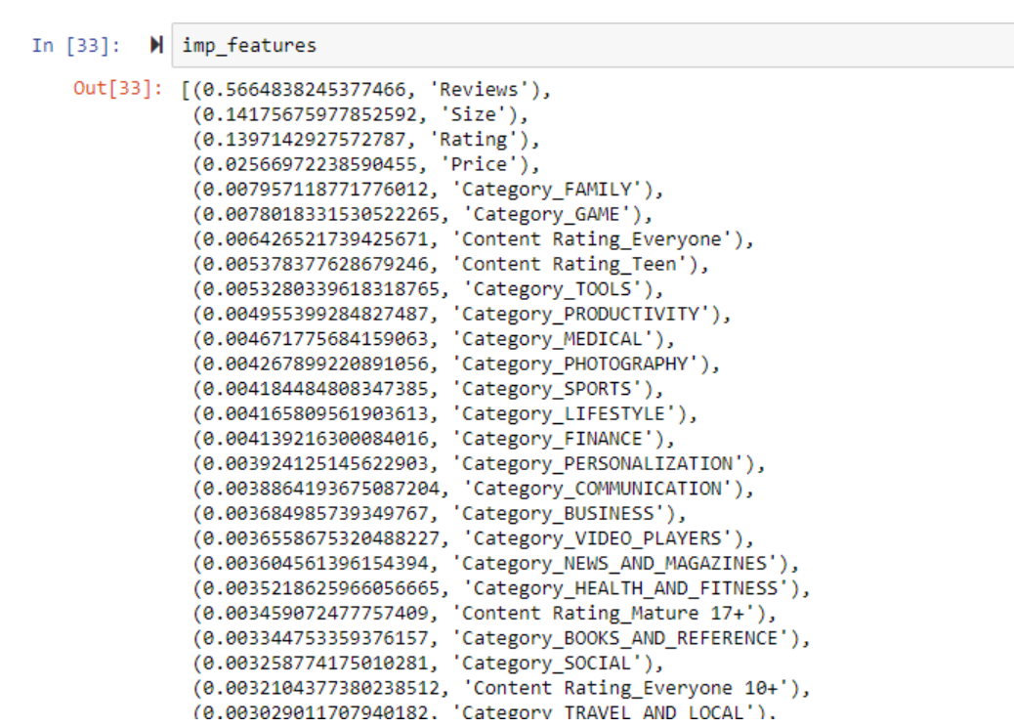
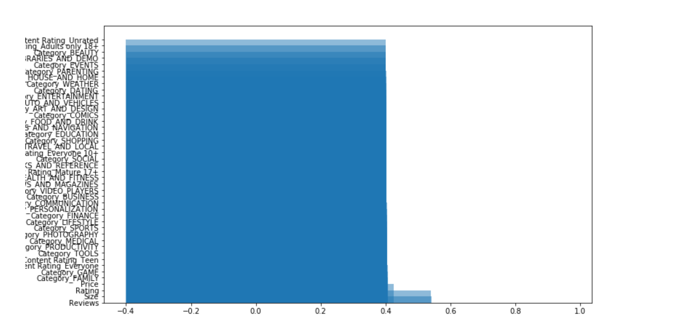
Finding A Model: Quest for >=0.80 Random Forest
Key takeaway: We used random forest model with all variables and model improved to 0.779

Slide 12
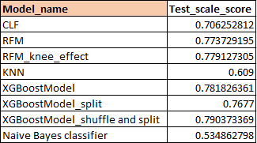
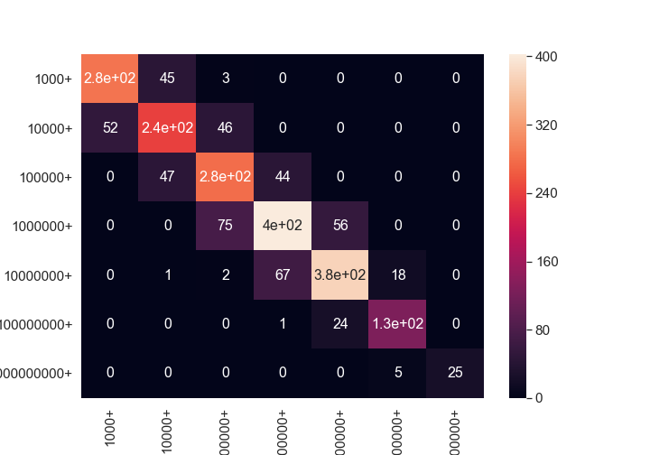
Finding A Model: Quest for >=0.80 XG Boost and other stuff
XG BOOST model – issue is that model always “overfits”
So to remove overfitting we tried XG Boost with RepeatedKFold, then Shuffle & Split
Confusion matrix:
Summary of Results:
Key takeaway: The best we score we achieved was 0.79 after trying several models – was something missing?

Slide 13

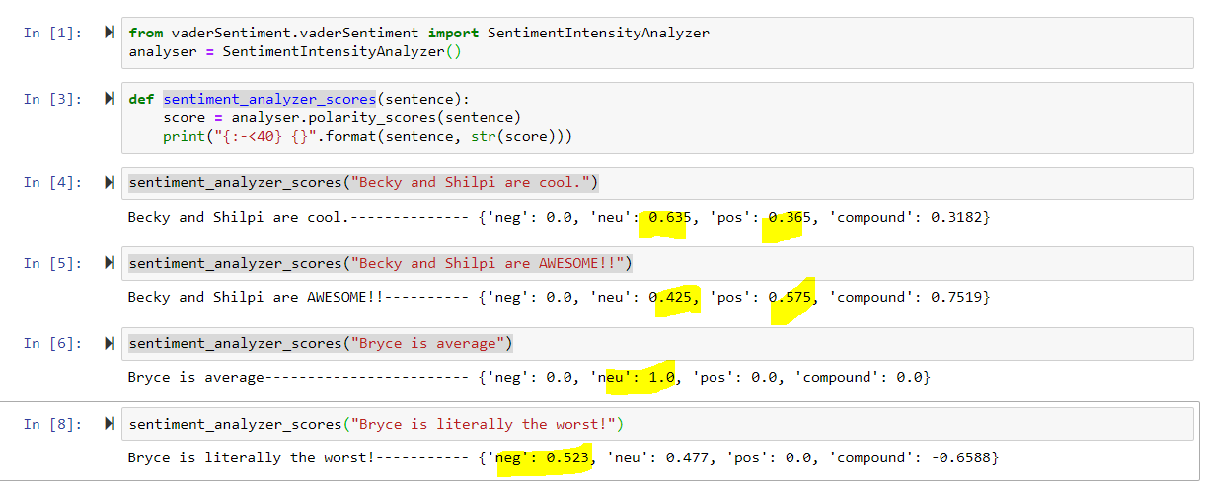
Vader analysis
VADER: Valence Aware Dictionary and sEntiment Reasoner
Note that Sentiment doesn’t actually begin with E, just saying.
What is VADER? lexicon and rule-based sentiment analysis tool that is specifically attuned to sentiments expressed in social media
What does it do? Analyzes text using a dictionary and ascribes sentiment score between 1 and -1.
Key takeaway: VADER analysis provides a score of written text from -1 to 1 where 0 is neutral, above 0 is positive and below 0 is negative

Slide 14
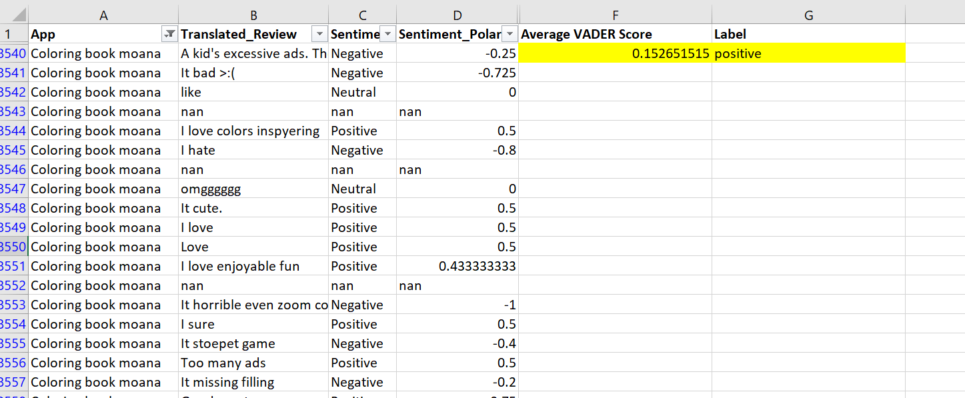
Vader analysis ADDED to Model
Original data did not have review text
Copying and pasting from Google Play Store prohibitively time consuming
Found data set of apps with Vader score already processed (☺)!
Used pivot to find average Vader score for apps by name
Resultant data set when adding in Vader scores shrunk from 8,892 to 817 (☹).
Key takeaway: Original data set shrank more than 91% after matching apps with Vader scores

Slide 15
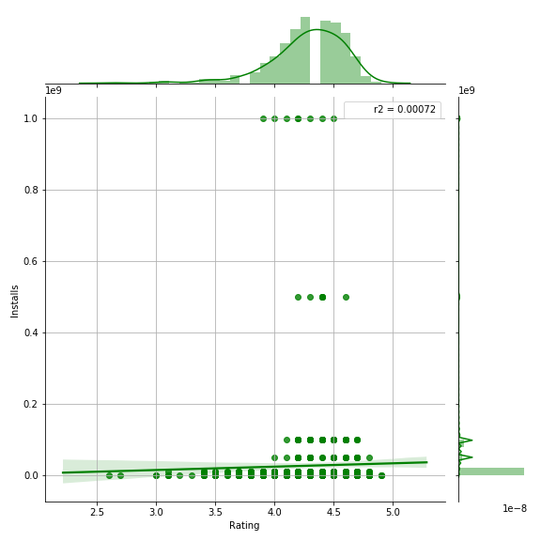
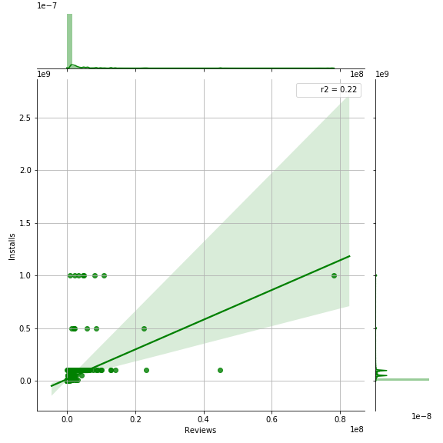
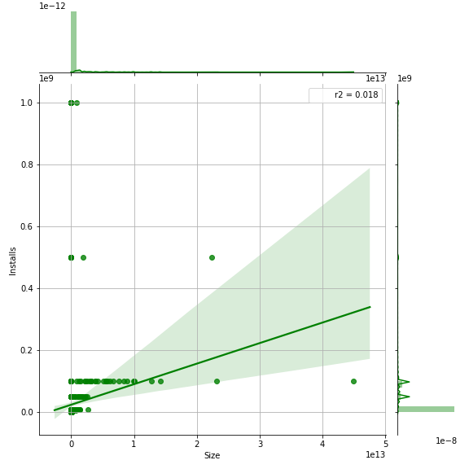
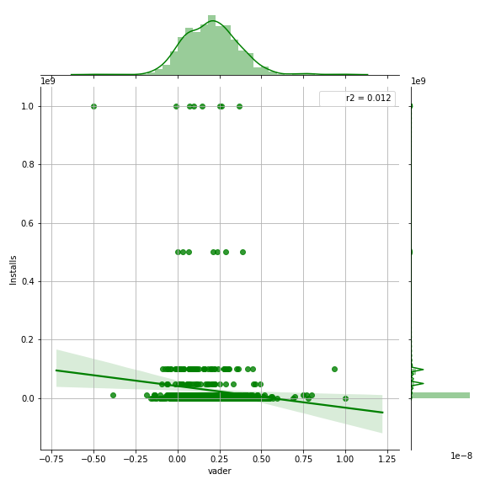
Finding A Model for 817: Significance of Numerical Data
Tested significance of variables by finding R^2 and P values using regression on numerical data only
Rating
Reviews
Size
Vader
R^2: 0.00072
P-value: 0.0001567932228658619
R^2: 0.22
P-value: 2.2687571481102595e-12
R^2: 0.018
P-value: 4.4837144595887125e-06
R^2: 0.012
P-value: 5.57808200e-13
Key takeaway: Number of Reviews still most statistically significant

Slide 16
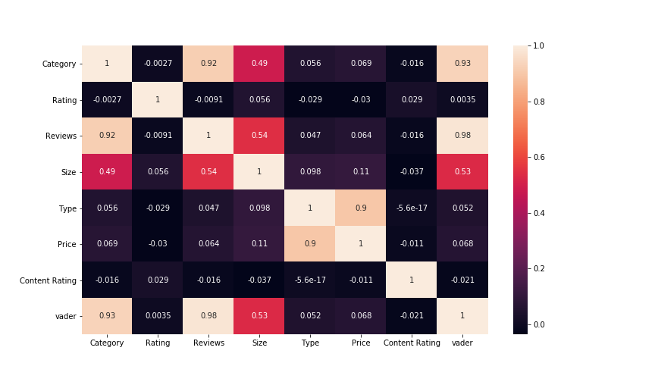
Finding A Model For 817: Significance of Categorical Data (Correlation)
Used label encoder to find out if columns in data set were correlated with each other
Key takeaway: Many variables correlated with each other, so we didn’t drop any using this table

Slide 17
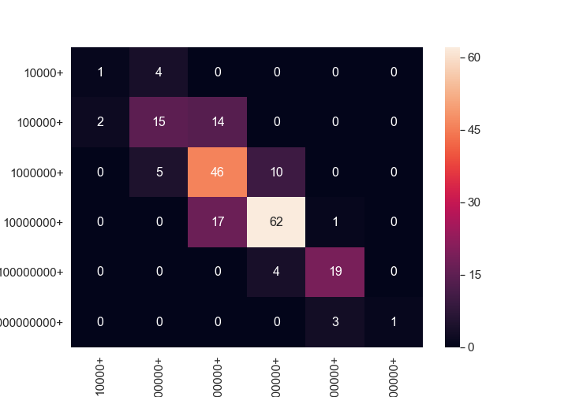
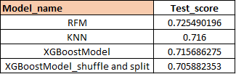
Finding A Model for 817: Quest for >=0.80; XG Boost and other stuff
XG BOOST model – issue is that model always “overfits”
So to remove overfitting we tried XG Boost with RepeatedKFold, then Shuffle & Split
Confusion matrix:
Summary of Results:
Key takeaway: Vader scores did not improve model. No models with 817 data points beat the original model score of 0.79

Slide 18
Summary
XGBoost Model with shuffle and split provided the best results for predicting app success with cleaned data set of 8,892 records (0.79)
Correlation Matrix, Lasso Regression, PCA were not useful in finding redundancies and paring down data
Adding Vader scores severely limited data set did not improve prediction capability
Possible bias in averaging Vader scores
More data may have improved overall score
Name errors may have added to data fall out
8,892 records W/O Vader
817 records WITH Vader
THANK YOU!

Slide 19
Questions?
Examples:
What is your favorite sports team?
Are you glad this is over?

